Slide 1
Fuzzy Inference System
Waliul islam sumon
Lecturer
Cse, kuet

Slide 2
Problems with Traditional (Boolean) Logic
A two-valued logic system: every statement is either True (1) or False (0).
A scenario of restaurant:
Two factors: Quality of food and quality of service
Outcome: Tip
If quality >= 8 and service >= 8, tip is 25%
If quality >= 5 and service >= 5, tip is 15%
Else, tip is 5%
10
25%
8
15%
Service
5
5%
5
8
10
Food

Slide 3
Fuzzy Logic
Fuzzy logic is a form of many-valued logic, where truth values are expressed in degrees between 0 and 1, instead of just true (1) or false (0).
A Fuzzy Inference System (FIS) is a way of mapping an input space to an output space using fuzzy logic.
FIS (also called a Fuzzy Expert System) uses membership functions and fuzzy rules instead of Boolean logic to reason with uncertain data.
The rules in FIS are fuzzy production rules of the form:
If P then Q, where P and Q are fuzzy statements.
P is called antecedent and Q is called conclusion.
E.x.: If service is poor or food is bad then tip is cheap.

Slide 4
Fuzzy Inference System
The set of rules in a fuzzy expert system is known as the knowledge base.
The main functional steps of a fuzzy expert system are:
Fuzzification – Convert crisp inputs into fuzzy values using membership functions.
Fuzzy Inference – Apply the fuzzy rules and inference method.
Aggregation – Combine the outputs of all rules.
Defuzzification – Convert the final fuzzy output into a crisp value.
Fuzzy Value
Crisp Value
Knowledge Base
Fuzzification
Inference Engine
Fuzzy Value
Crisp Value
Defuzzification

Slide 5
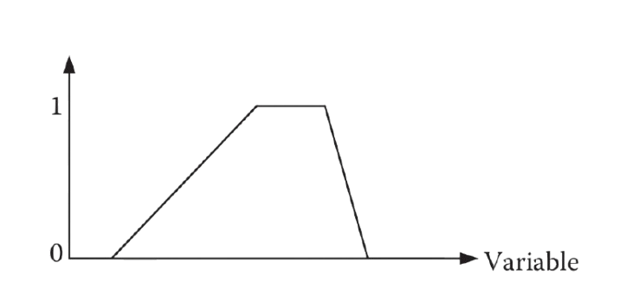
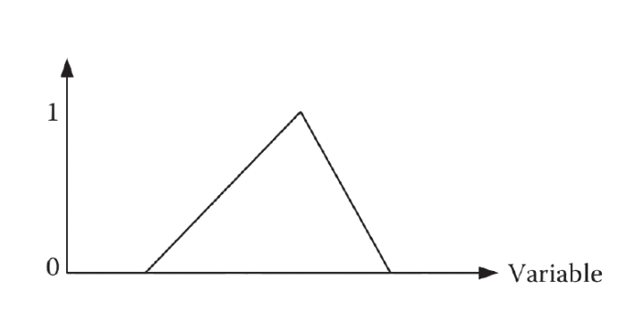
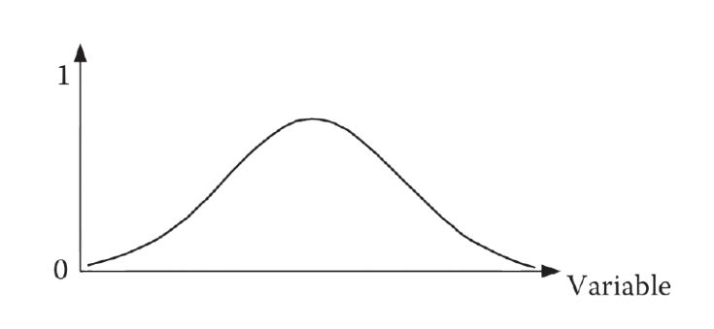
Fuzzy Inference System – Cont’d
Some common membership functions:
A trapezoidal membership function
A triangular membership function
A gaussian membership function

Slide 6
Mamdani Inference System
The most well-known fuzzy inference system is the Mamdani rule-based system.
Its functional steps are:
Fuzzify all input values into fuzzy membership functions.
Execute all applicable rules in the rulebase to compute the fuzzy output functions.
Defuzzify the fuzzy output functions to get "crisp" output values.
Example: We will consider the restaurant tipping scenario.
Two inputs: Quality of food and service at a restaurant rated at scale from 0-10.
One output: Amount of tip to be given (in the range 5%-25% of total bill paid).

Slide 7
Rules for Tipping
Let us consider the following three rules:
If service is poor or food is bad, then tip is cheap .
If service is good, then tip is average.
If service is excellent or food is delicious, then tip is generous.
Input variables:
Service : represented by poor, good, excellent
Food : represented by bad, delicious
Output Variable:
Tip : represented by cheap, average, generous

Slide 8
Membership Functions
Poor
Good
Excellent
Bad
Delicious
1
1
Membership
Membership
0
0
0
2
4
5
6
8
10
0
3
5
7
10
Quality of Service
Cheap
Average
Generous
Quality of Food
1
Membership
0
5
10
13
15
17
20
25
Amount of Tip (%)

Slide 9

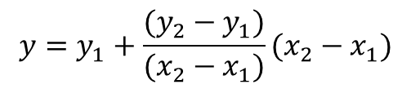

Fuzzification
Let:
Service = 3, Food = 6
Poor
Good
Excellent
Bad
Delicious
1
1
Membership
Membership
0
0
0
2
4
5
6
8
10
0
3
5
7
10
Quality of Service
Quality of Food
$$y=y_{1}+\frac{(y_{2}−y_{1})}{(x_{2}−x_{1})}(x_{2}−x_{1})$$
Service(3) = (0.5, 0.33, 0)
Food(6) = (0.25, 0.75)

Slide 10
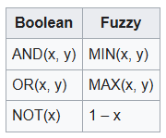



Inferencing (Executing Rules)
Service(3) = (0.5, 0.33, 0)
Food(6) = (0.25, 0.75)
If service is poor or food is bad, then tip is cheap .
If service is good, then tip is average.
If service is excellent or food is delicious, then tip is generous.
OR(0.5, 0.25) = MAX(0.5, 0.25)
0.33
OR(0, 0.75) = MAX(0, 0.75)
Tip = (0.5, 0.33, 0.75)

Slide 11

Defuzzification
Tip = (0.5, 0.33, 0.75)
Cheap
Average
Generous
1
0.75
Membership
0.5
0.33
0
5
10
13
15
17
20
25
Amount of Tip (%)
There are several defuzzification methods, here we will use centroid technique.
It finds the point where a vertical line would slice the aggregate set into two equal masses.

Slide 12
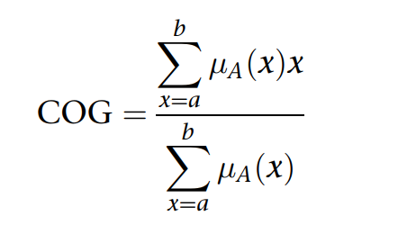

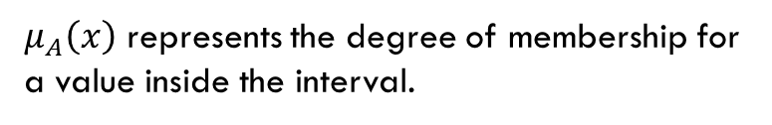
Defuzzification – Cont’d
Cheap
Average
Generous
1
0.75
Membership
0.5
0.33
0
5
10
13
15
17
20
25
Amount of Tip (%)
A centroid defuzzification method finds a point representing
the center of gravity of the fuzzy set, A, on the interval, ab is given by the equation:
$μ_{A}\left(x\right)$ represents the degree of membership for a value inside the interval.

Slide 13
Defuzzification – Cont’d
Cheap
Average
Generous
1
0.75
Membership
0.5
0.33
0
6
8
10
12
14
16
18
20
22
24
Amount of Tip (%)
$$COG=\frac{\left(6+8+10\right)∗0.5+\left(12+14+16+18\right)∗0.33+\left(20+22+24\right)∗0.75}{0.5+0.5+0.5+0.33+0.33+0.33+0.33+0.75+0.75+0.75}$$
= 16.03%

Slide 14
Visualization
Code: https://colab.research.google.com/drive/1gp3VcCxj3t3XyK3c9DCfT1G7B3HWjFLr?usp=sharing

Slide 15
Thank you

